Slide 1
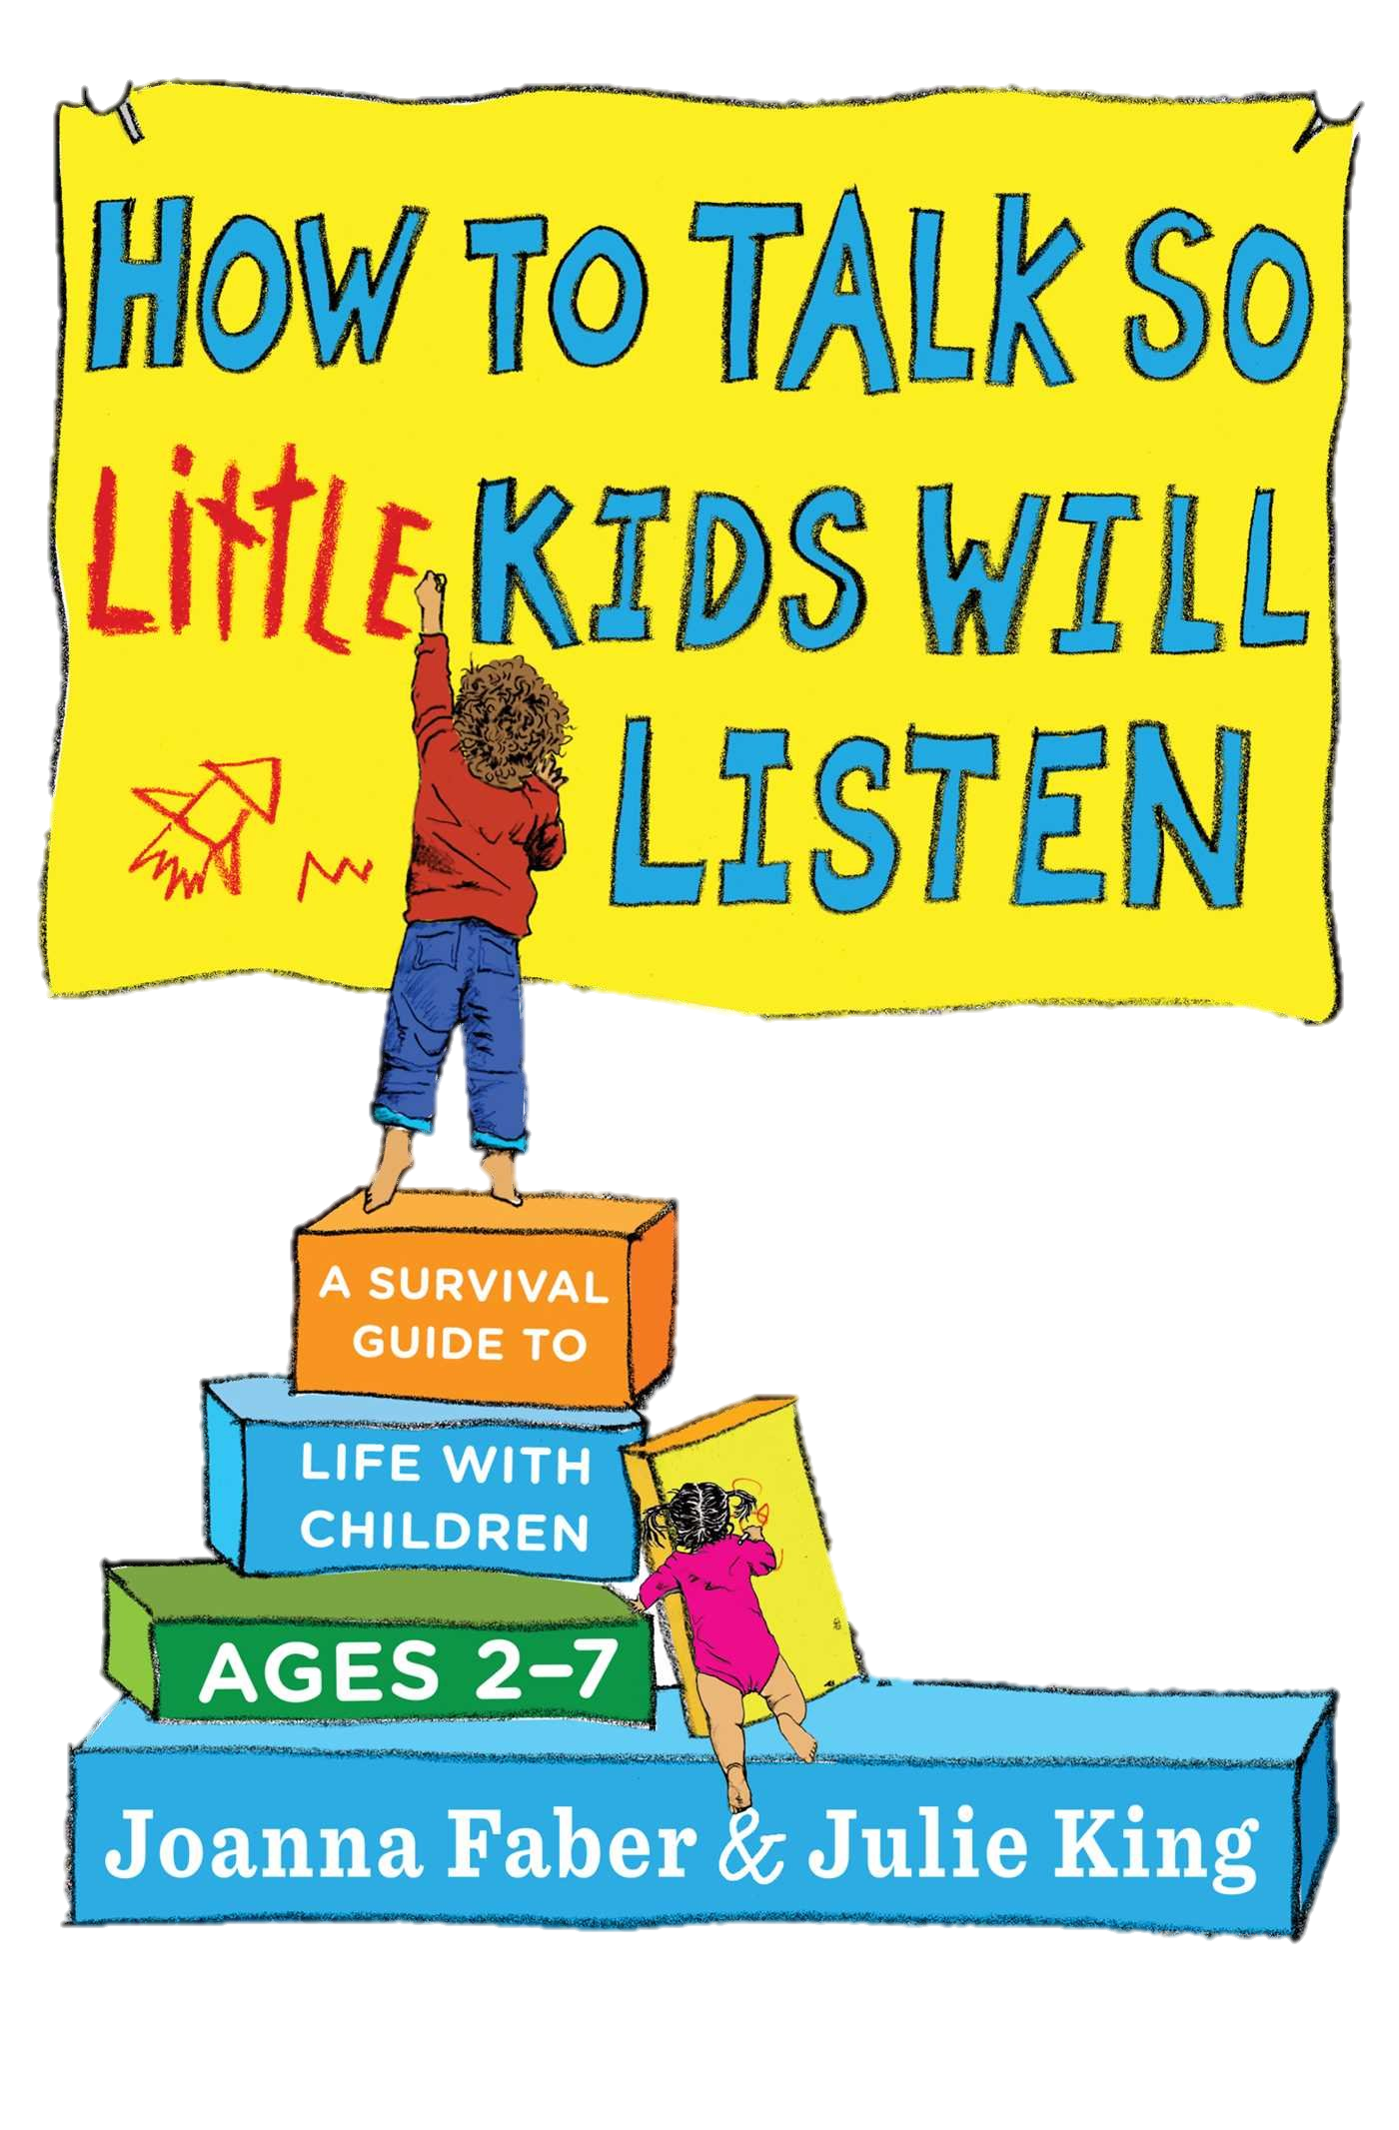

Slide 2
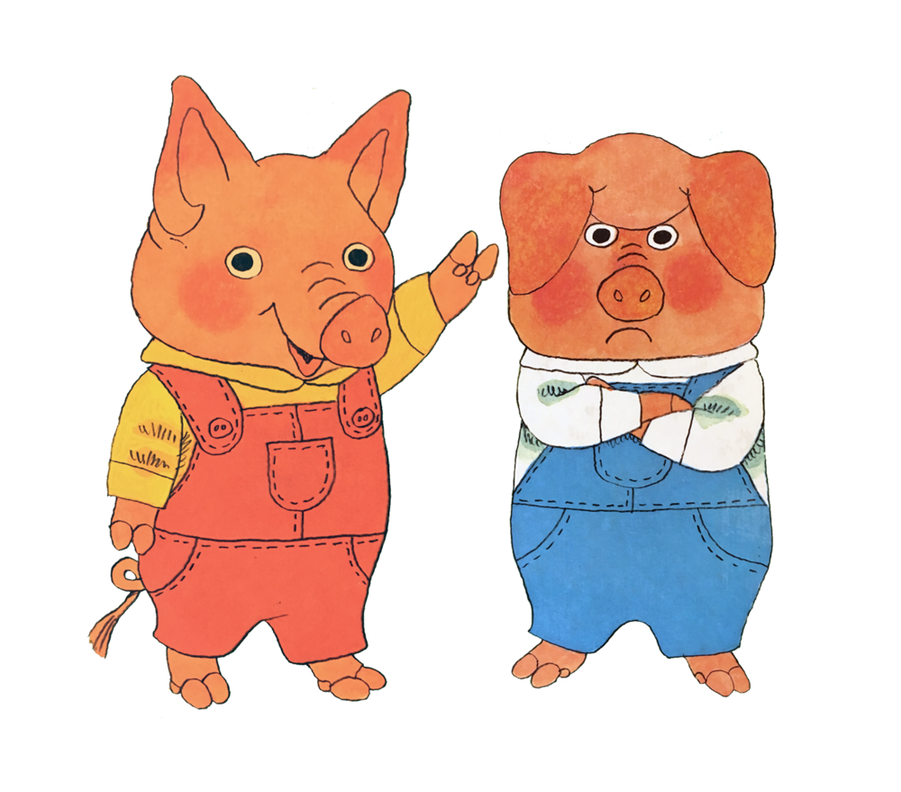
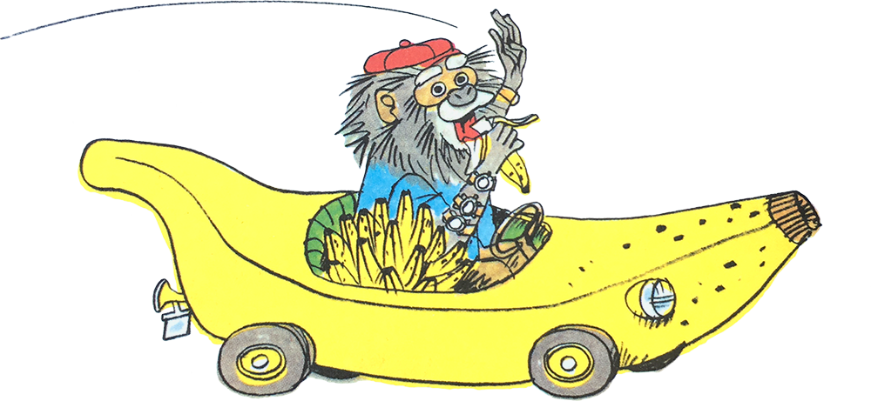
Handling Emotions
Tool 1: Acknowledge feelings with Words
“You wanted to continue to do X. How disappointing!”
“It can be so frustrating when X, Y, Z falls apart, breaks etc.”
Tool 2: Acknowledge feelings with Writing
“We don’t have that on our shopping list, write it down!”
“You really want that toy. Write it down for Santa or gifts!”
Tool 3: Acknowledge feelings with Art
“You are sad, sad, sad” [draw a stick figure with tears or give the pencil to your child to have them show it off]”
“You are this angry” [draw an anger line]
Tool 4: Give into the Fantasy of what you cannot give in Reality
“I wish we had a billion more hours to play”
Tool 5: Acknowledge feelings with silent attention
“Ugh!” “mm” “ooh” “huh”
IMPORTANT NOTES
Resist the urge to ask questions of a crying child: instead you should draw or describe or express fantasy…always acknowledge
All feelings can be acceptable. Some actions must be limited! Instead of acknowledge and then “But”, substitute with “the problem is…” or
“Even though you know…”
Mirror their emotions. Oscar performances help.
Engaging Cooperation part 1
Tool 1: Say It with a Word (or Gesture)
“Garbage!” “Blocks!” “Bedtime!” “Toys!” for clean up
Tool 2: Be Playful
Make it a game “Can we get to the bath tub before the timer beeps? Ready, Steady, Go!”
Make inanimate objects talk “I’m an empty glove. I need a hand”
Use silly voices and accents “I am an airplane flying into your mouth”
Pretend “We’re going through the enchanted forest to bed time.”
Play the incompetent fool “Where does this shoe go? On your head? On your arm? So confusing!
Tool 3: Offer a Choice
“Do you want to skip like a bunny or crawl like a crab…to bed.”
Tool 4: Put the Child In Charge
“Martha would you set the timer to let us know when to stop?”
“You are this angry” [have her draw an anger line]
Tool 5: Give Information
“Garbage goes in the trash” “Hands are not for hitting.”
Based on “how to talk so your small kids will listen” Joanna Faber and Julie King
Based on “how to talk so your small kids will listen” Joanna Faber and Julie King

Slide 3
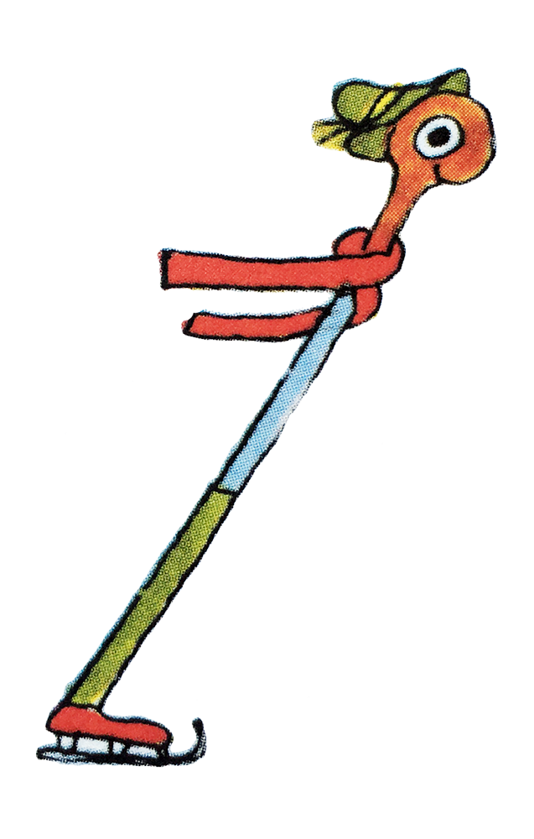
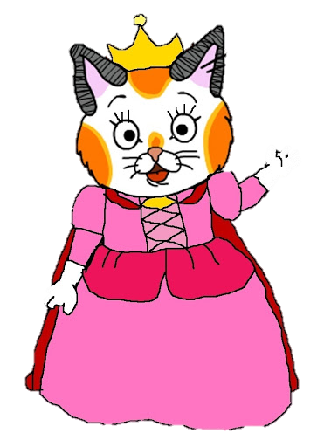
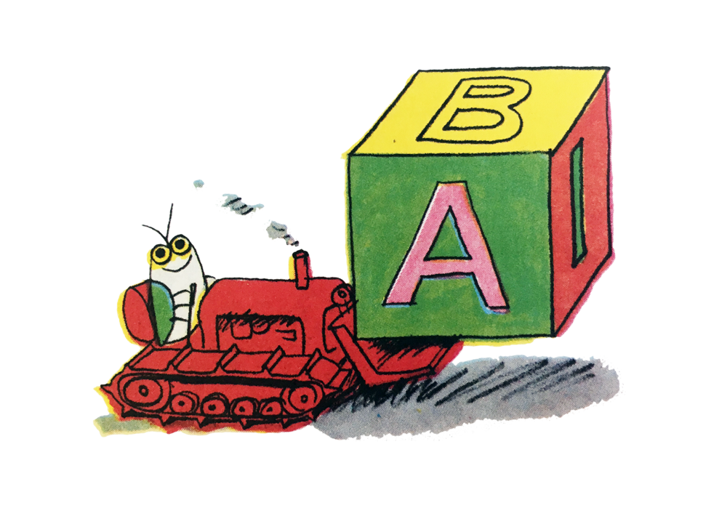
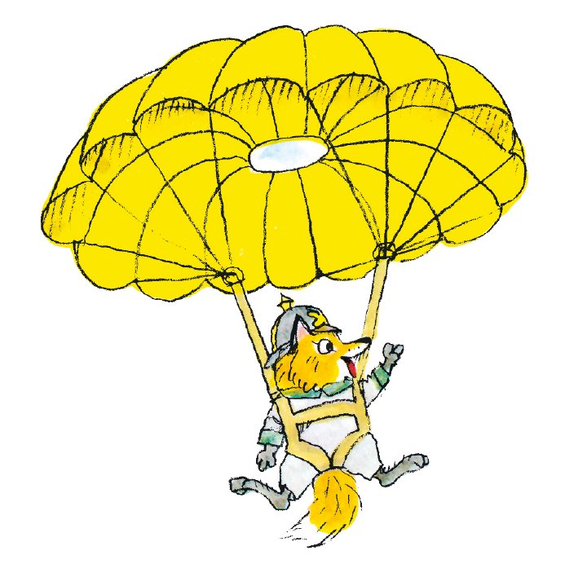
Praise and Appreciation
Tool 1: Describe What You See
“I see green lines that are zooming up and down the page. And look how they connect all these read shapes!”
Tool 2: Describe the Effect on Others
“The baby loves it when you make those funny sounds. I see a big smile on her face.”
Tool 3: Describe Effort
“You kept working on that button until you got it into that little button hole!”
Tool 4: Describe Progress
“You sounded out each of the letters and you put them together. You read a whole sentence!”
IMPORTANT NOTES
Consider asking questions or starting a conversation instead of praising.
Sometimes acknowledging feelings can be more helpful than praise.
Give a child a new picture of himself.
Resist the urge to praise by comparison.
Engaging Cooperation part 2
Tool 6: Describe What You See
“I see most of the blocks put away in the toy box. There are only a few blocks left to go.”
Tool 7: Describe How You Feel
“I don’t like X” “I don’t like y” “I am frustrated” never “You did x, y….”
Tool 8: Write a Note
“Put me on your head before riding. Loy your bike helmet”
Tool 9: Take Action Without Insult
“I’m putting X away for now. I can’t let you Y others”
IMPORTANT NOTES
Don’t turn choices into threats. Make sure the options are acceptable to you and your child.
Appreciate progress before describing what’s remaining to complete.
When expressing disapproval, always use “I” rather than “you.”
Express strong reactions sparingly, it can feel like an attack.
Based on “how to talk so your small kids will listen” Joanna Faber and Julie King
Based on “how to talk so your small kids will listen” Joanna Faber and Julie King

Slide 4
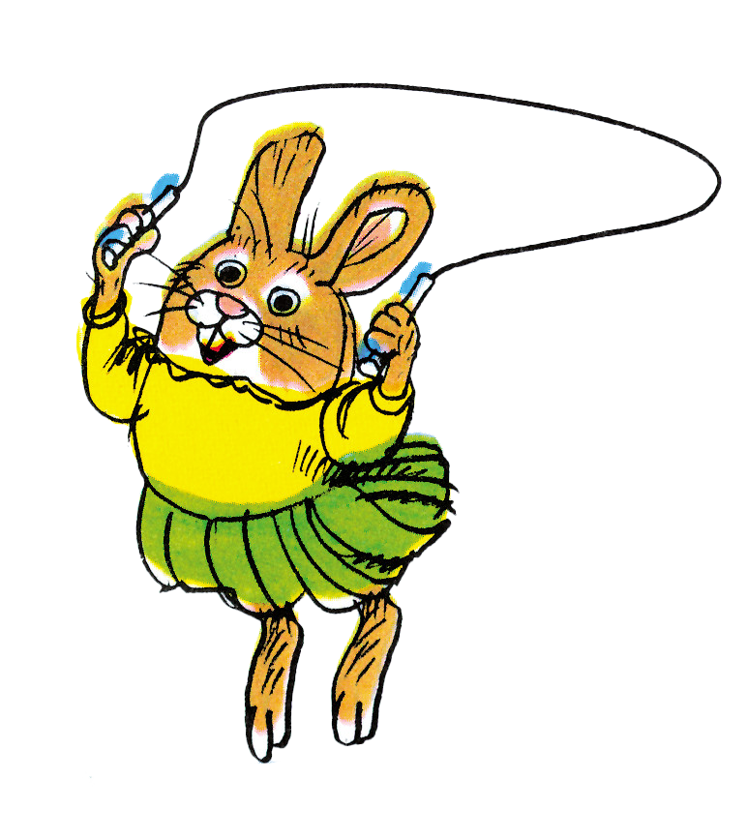
Resolving Conflict part 1
Tool 1: Express Your Feelings….Strongly
“Hey, I don’t like to see people being pushed around!”
Tool 2: Show Your Child How to Make Amends
“Your brother was scared by you. Let’s do something to make him feel better. Perhaps give him X?”
Tool 3: Offer a Choice
“We’re going to give the see-saw a rest. I can see you are in no mood to wait for your turn. Swing or sandbox. You decide.”
Tool 4: Take Action Without Insult
“We’re heading to the car. We’ll try the backyard another day. I’m too worried about children getting pushed right now.”
IMPORTANT NOTES
If nothing is working, then you may have to reconsider your basic expectations: blood-sugar, sleep
You don’t have to wait for a problem to occur in order to use problem-solving. When possible, plan ahead!
Show respect for the conflict. Don’t minimize.
Remove the disputed object temporarily.
Based on “how to talk so your small kids will listen” Joanna Faber and Julie King

Slide 5
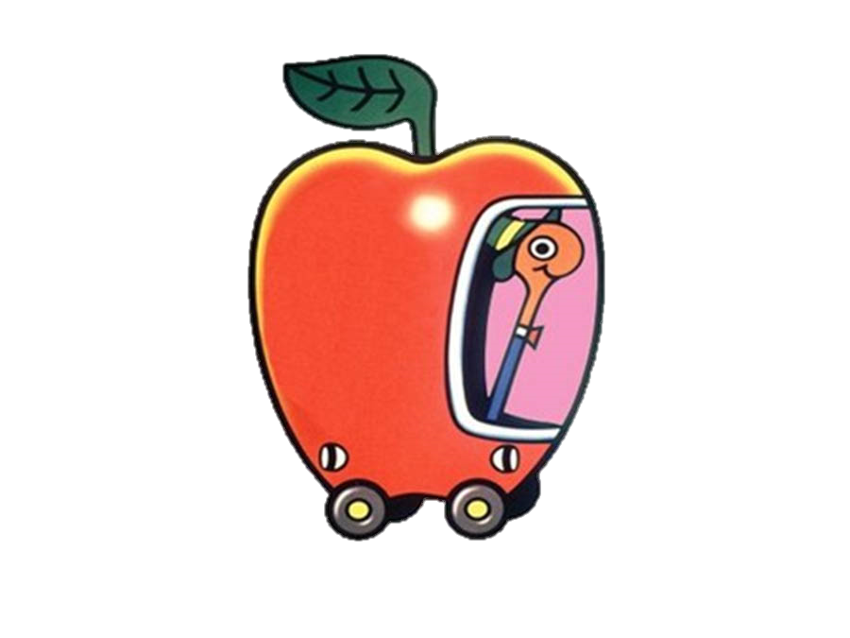
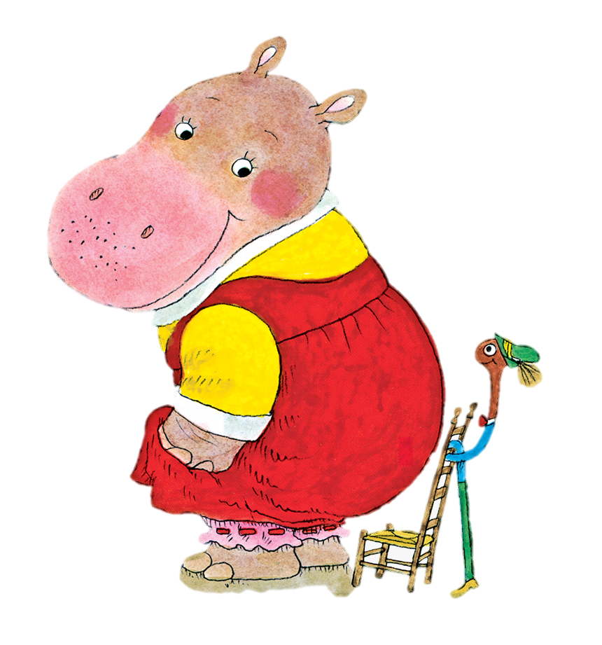
Resolving Conflict part 2
Tool 5: Try Problem-Solving
Step One: Acknowledge Feelings
“I can see that you don’t want to hold my hand. It makes your fingers feel squeezed. Let’s solve this problem.”
Step Two: Describe the Problem
“The problem is, I worry about children slipping in the parking lots”
Step Three: Ask for Ideas, Put them in a table
“We need some ideas so we can go back to the park and have a good time without people getting mad or scared. What can we do?”
Step Four: Decide which ideas you both like
“So you like the idea of holding on to my sleeve and leading me to the playground.”
Step Five: Try out your solutions
“Here we are at the parking lot. Grab my sleeve and
show which way to go!”
Based on “how to talk so your small kids will listen” Joanna Faber and Julie King

Slide 6
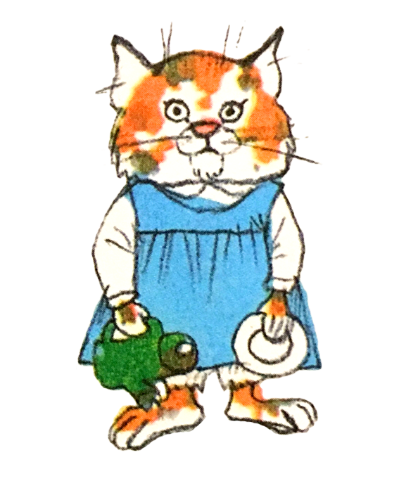
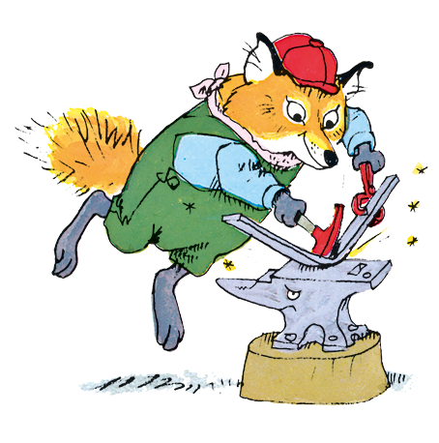
Sibling Rivalry
Tool 1: Accept Feelings
“It can be frustrating to have a baby sister!”
Tool 2: Give Wishes in Fantasy: let the child be a baby
“Come sit on my lap and be my super baby!”
Tool 3: Describe What You See:
“You figured out how to cheer up your sister when she’s crying”
Tool 4: Put the Child In Charge
“Can you pick a board book for the baby? She likes it when you read to her.”
Tool 5: Reconned with Your Child
Plan for a special One-on-One Time
“Would you like to make cookies when the baby takes her nap? Or snuggle up and read your pop-up books?”
Tell the older child about their Baby Days “I remember you…”
Tool 6: Take Action Without Insult
Don’t cast the child as the aggressor “I need to separate you two.”
Tool 7: Try Problem-Solving don’t take sides
“Both Martha and Daphne want to build towers. Any ideas?”
Lies
Tool 1: Describe What You See
“I see chocolate on your face.”
Tool 2: Describe How You Feel
“I’m upset that the cake was eaten! I wanted to serve it.
Tool 3: Acknowledge Feelings
“It’s not easy to resist cake. I bet you wish you hadn’t eaten it.”
Tool 4: Try Problem Solving
“Next time you’re tempted, let me know. I’m sure we can find a way to help you wait.”
Tool 5: Adapt Expectations
Think to yourself, the next time I buy a chocolate cake, I’ll put it out of sight until it’s time for dessert.
Tool 6: Help the Child Make Amends
“We’re going to need something for dessert. Can you get out some cookies and arrange them on a plate?”
Based on “how to talk so your small kids will listen” Joanna Faber and Julie King
Based on “how to talk so your small kids will listen” Joanna Faber and Julie King

Slide 7
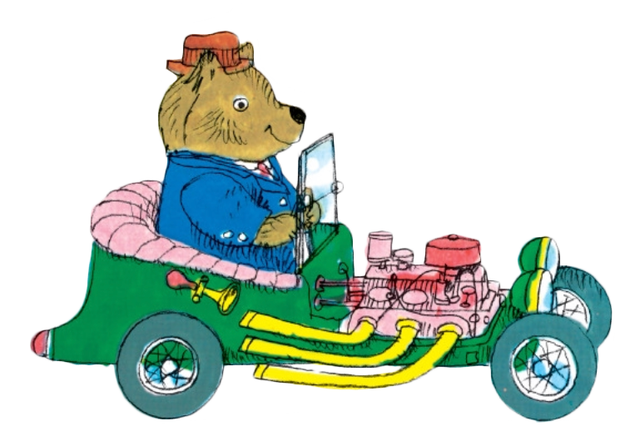
Differently Wired Kids
Tool 1: Join them In their World
“Can I play the Space Game with you? Will you show me how?”
Tool 2: Take Time to Imagine What Your Child Is Experiencing
“So to you, the seams of the socks are very irritating!”
Tool 3: Put into works what Kids Want to Say
“You bad old rain! You took away Johnny’s recess!”
Tool 4: Adjust Expectations: Manage the Situation not the Kid
“Let’s take a diaper vacation. We need some time to relax and not worry about peeing in the potty.”
Tool 5: Use Alternatives to the Spoken Word
Notes, Checklists, Pictures, Songs, Gestures
Tool 6: Tell Them What They Can Do, Instead of What they Can’t
Notes, Checklists, Pictures, Songs, Gestures
Tool 7: Be Playful
“It’s time to put away the blocks. I need help from the human wheelbarrow”
CONDITIONS WHERE THIS FAILS: Lack of food, lack of sleep, overwhelmed, developmentally not ready, need for recovery time.
Eating Food
Tool 1: Acknowledge Feelings
“Even if you usually like lasagna, you’re in no mood for it tonight.”
Tool 2: Offer Choices
Put an empty plate in front of your child and let him serve himself, or ask for what he wants if he’s too young to serve himself.
Serve some of the meal as simple separates so kids can make choices about what they put on their plate.
Offer a simple alternative if kids don’t want the “grown-up” food – peanut butter sandwich, bread and cheese, hard-boiled egg.
Tool 3: Manage the Environment
Make it easy to avoid temptation! Keep sugary drinks hidden
Tool 4: Put the Child in Charge
Let the kids plan the shopping, meal prep and other planning
Tool 5: Give Information
Let kids know that ‘tastes change” so they don’t feel stuck with their limited palate. Tell them “You might
want to give this a try when you’re ready”
Based on “how to talk so your small kids will listen” Joanna Faber and Julie King
Based on “how to talk so your small kids will listen” Joanna Faber and Julie King

Slide 8
Cleanup
Tool 1: Be Playful
Talking shoes “Please put me in the closet”
“How many minutes to put away your toys?”
Tool 2: Offer a Choice
“Do you want to be in charge of putting away the books or car?”
Tool 3: Write a Note
“Please hang me on the hook. Love, Your Winter Coat.”
Tool 4: Describe What You See
“I see banana peels on the floor.”
Tool 5: Give Information
“Peels belong in the compost”
Tool 6: Say it with a Word
Tool 7: Describe Progress
“You got that whole pile of dirty laundry in the basket!”
Tool 8: Describe What You See with Appreciation
“Wow, look at this cleanup you did. The floor was
covered with dirty laundry and train tracks, and now
it’s cleared.”
Parent Have Feelings Too
Tool 1: Express Your Feelings…Strongly
“Instead of “You’re being rude!” Try “I don’t like being told I’m mean. It makes me mad.”
Tool 2: Tell Them What They Can Do, Instead of What They Can’t
“You can tell me, “Mommy, I’m disappointed! I wanted to go!”
Tool 3: Don’t Do Basics – Give Yourself and Your Child Time to Recover
“I’ll talk to you about it after dinner. Right now I’m too upset.”
Tattling
Tool 1: Acknowledge Feelings “It hurts to be poked!”
Tool 2: Help Make Amends “Let’s clean up the mess”
Tool 3: Try Problem Solving
“How will we remember not to touch the stove dials?....
We need ideas!!!!”
Based on “how to talk so your small kids will listen” Joanna Faber and Julie King
Based on “how to talk so your small kids will listen” Joanna Faber and Julie King

Slide 9
Little Runaways
Tool 1: Adjust Expectations: Manage the Environment Instead of the Child
Avoid outings that seem like fun but will be more stress than pleasure with a small child.
Tool 2: Acknowledge Your Child’s Feelings
“You don’t like it when your hand is squeezed. You want to be free to look around.”
Tool 3: Describe Your Own Feelings
“I worry that drivers backing out of parking spaces can’t see children.”
Tool 4: Offer a Choice
“You can ride in the cart or you can help push.”
Tool 5: Be Playful
“We need to stick close together. It’s a jungle out there. I think I just saw the tail of a lion behind that car.”
Tool 6: Try Problem-Solving
“Let’s think of a secret signal we can use that means we have to get to each other as fast as possible.”
Tool 7: Take Action Without Insult
Grab your child and go home
Shy Kids
Tool 1: Acknowledge Feelings
“It can be hard to walk into a new house filled with relatives. Lots of people want to say hello to you. That can feel scary.”
Tool 2: Adjust Expectations
“You can carry in the chips and put them int the bowl for people to eat.”
Tool 3: Offer a Choice
“Do you want to sit on the couch and watch kids set up the trains? Or do you want to have a snack with the grown-ups first?”
Tool 4: Be Playful
(Sock puppet talking) “Would you like a corn-chip?”
Tool 5: Put the Child in Charge
“He will join you when he’s ready!”
Based on “how to talk so your small kids will listen” Joanna Faber and Julie King
Based on “how to talk so your small kids will listen” Joanna Faber and Julie King

Slide 10
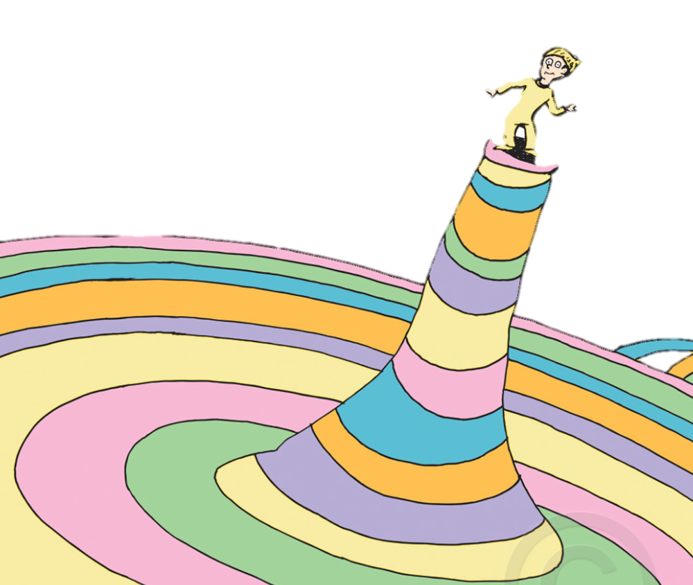
Troubleshooting part 1
Tool 1: When a child is too upset to cooperate,
go back to Acknowledging Feelings
“You don’t even want to think about visiting your friend another time. You were looking forward to going today!”
Make sure your tone of voice matches the emotion
“That’s so disappointing!”
Try a grunt a instead of words
“Ugh!” “Mmph!”
Put your child’s thoughts into words
“Stupid Legos! They should stick together and stay together!”
Tell the Story of what happened
“You worked for a long time on that spaceship. You used blue blocks for the base and red bricks for the lights and it was almost ready to launch! All it needed was the fins on the rockets.”
Based on “how to talk so your small kids will listen” Joanna Faber and Julie King

Slide 11
Troubleshooting part 2
Tool 2: Give your child Time to Recover
“I can see how sad you are. I’ll be in the kitchen making dinner. Come join me when you’re ready!”
Tool 3: Help a child climb out of the pit of despair by Acknowledging Feelings, Giving Information, and Offering Choices
“Oh no, the skin got ripped! That hurts! Good thing skin knows how to repair itself. It’s getting busy right now growing more skin cells to cover that poor knee and make it as good as new. How many days do you think it will take? What kind of Band-Aid should we cover it with?”
Tool 3: Describe Your Own Feelings
“I worry that drivers backing out of parking spaces can’t see children.”
Tool 4: Take Action
“You want candy for breakfast! I’m putting it out of sight. It’s eggs or cereal this morning.”
Tool 5: Check on “The Basics”
Is your child lacking food or sleep, or feeling overwhelmed? Is your child developmentally ready to do what you’re expecting?”
Based on “how to talk so your small kids will listen” Joanna Faber and Julie King

